Slide 1

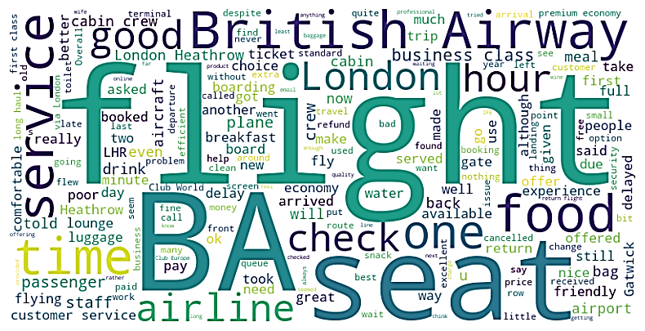

Forage British Airways Data Science Job Sim Task 1 : Web scraping to gain company insights
There are a total of 3701 reviews given for British Airways on Skytrax
Out of which 1923 reviews/trips are verified
254 reviews/trips are unverified
1524 reviews/trips are neither verified nor unverified
Analysis for Verified Trips: -
From the wordcloud plot we can infer that the following words were used the most for giving a verified review: -
flight
seat
London
service
check
one
time
good
food
hour
airline
BA

Slide 2
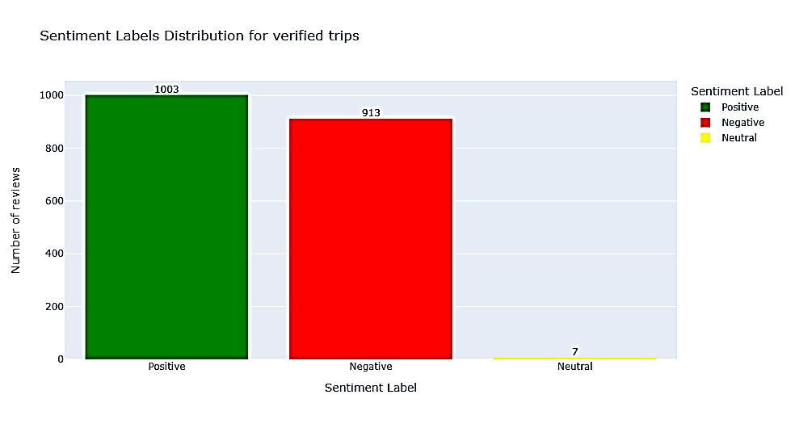
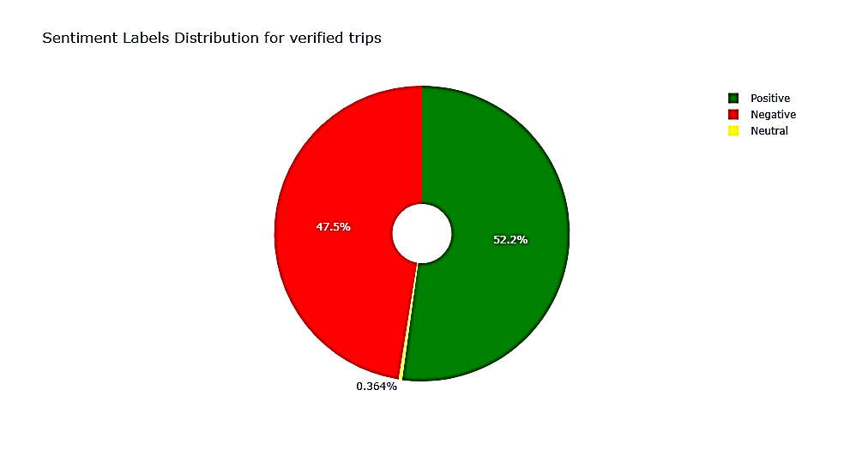
Forage British Airways Data Science Job Sim Task 1 : Web scraping to gain company insights
Analysis for Verified Trips: -
-> The average sentiment score is 0.07
There are 1003 (52.2%) positive reviews of the total 1923 verified reviews
There are 913 (47.5%) negative reviews of the total 1923 verified reviews
There are 7 (0.364%) neutral reviews of the total 1923 verified reviews

Slide 3
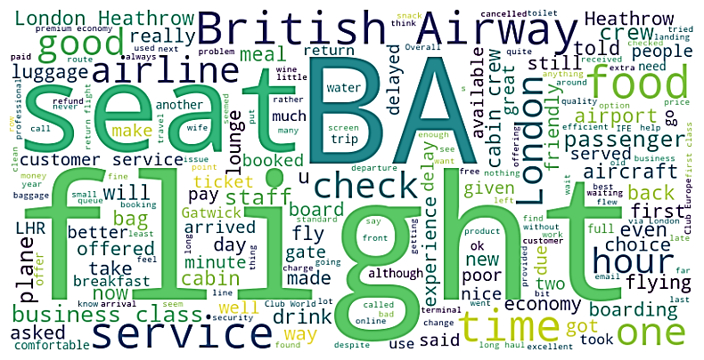
Forage British Airways Data Science Job Sim Task 1 : Web scraping to gain company insights
Analysis for Unverified Trips: -
From the wordcloud plot we can infer that the following words were used the most for giving a unverified review: -
flight
seat
London
Heathrow
service
check
one
time
good
food
hour
airline
BA
business class
flying

Slide 4
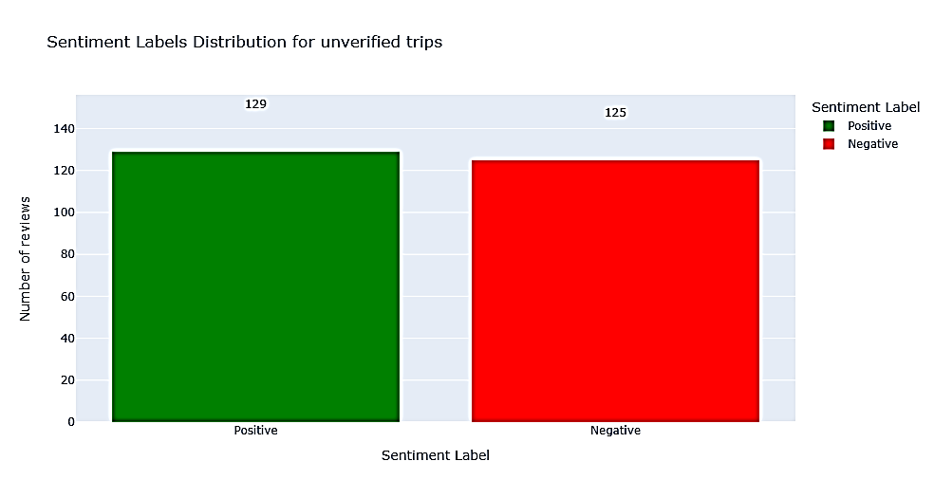
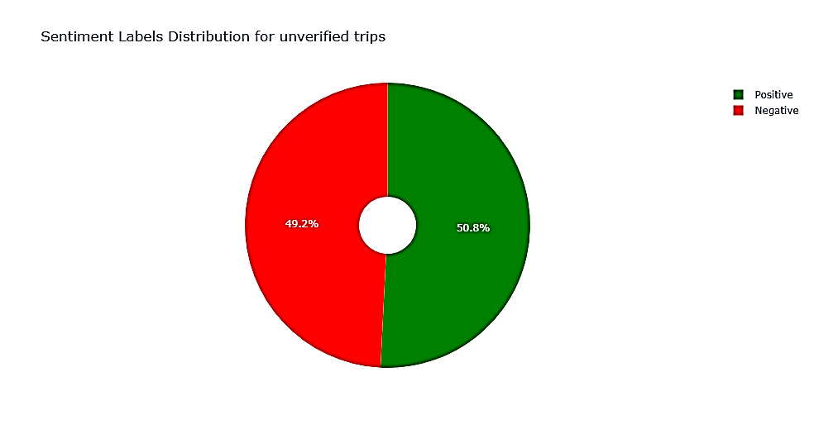
Forage British Airways Data Science Job Sim Task 1 : Web scraping to gain company insights
Analysis for Unverified Trips: -
-> The average sentiment score is 0.04
There are 129 (50.8%) positive reviews of the total 254 unverified reviews
There are 125 (49.2%) negative reviews of the total 254 unverified reviews

Slide 5
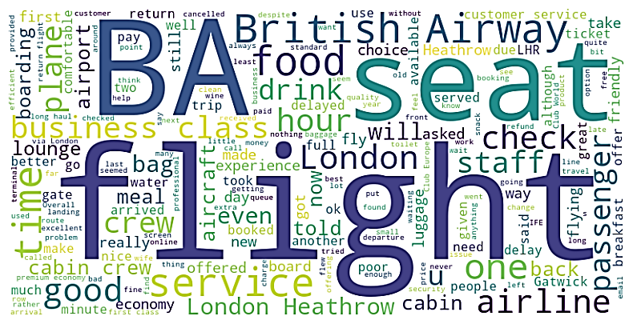
Forage British Airways Data Science Job Sim Task 1 : Web scraping to gain company insights
Analysis for neither Verified nor Unverified Trips: -
From the wordcloud plot we can infer that the following words were used the most for neither Verified nor Unverified Trips : -
BA
seat
flight
British Airway
London
Heathrow
airline
cabin
check
business class
hour
good
passenger
time
lounge
drink

Slide 6
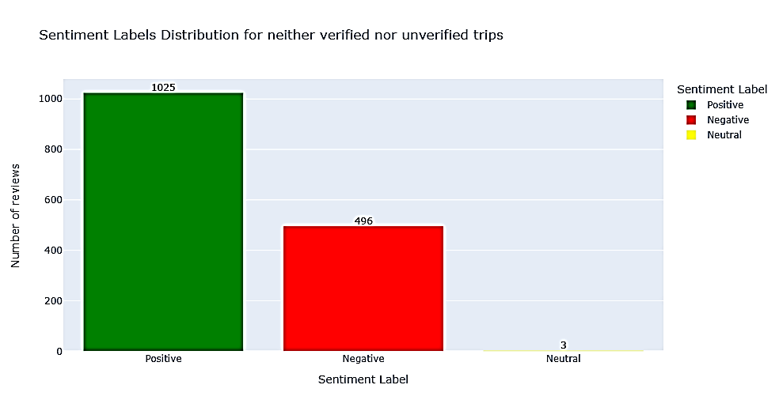
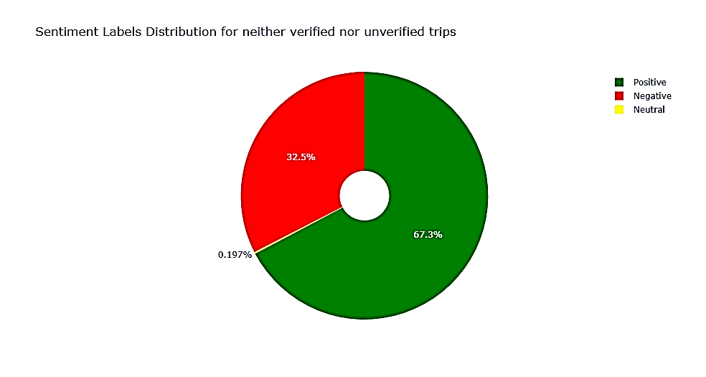
Forage British Airways Data Science Job Sim Task 1 : Web scraping to gain company insights
Analysis for neither Verified nor Unverified Trips: -
-> The average sentiment score is 0.31
There are 1025 (67.3%) positive reviews of the total 1524 neither verified nor unverified reviews
There are 496 (32.5%) negative reviews of the total 1524 neither verified nor unverified reviews
There are 3 (0.197%) neutral reviews of the total 1524 neither verified nor unverified reviews

